Slide 1
Lecture:
Last Time:
Control Lines and the CPU
On-Off Switch
Decoder to select which register.
Mux to select ALU Output
CPU Overview: Data with some control lines.
High-level memory schematic
Questions
Today:
Sequential Circuits: clocks, latches, and flip/flops:
CPU Control: PC/IR
MIPS pipeline architecture
Next: Onto Assembly Language Program:
Assembly Level Programming
Three-address code
MIPS assembly code

Slide 2
Sequential Circuit
Sequential circuit infuses a memory component
Memory serves as both input and output
A clock is used to trigger the update of the memory unit
Combinational Circuit
Inputs
Outputs
Memory Unit
Clock

Slide 3
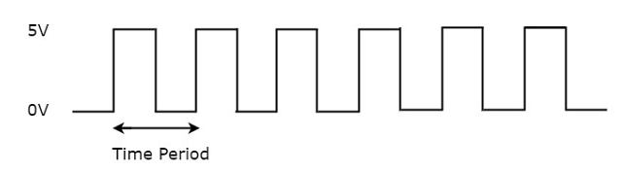
Clock: an electronic device
Generates a periodic signal
Forms a square wave
Frequence = 1 / (Time Period)
Used as a control signal to active parts of a circuit
Types of Triggers:*
Level Trigger
Edge Trigger
Level of Triggers:
Positive Level (Hi)
Negative Level (Lo)
* Recall you can active some GUI elements on a mouse click, mouse press, OR a mouse release

Slide 4
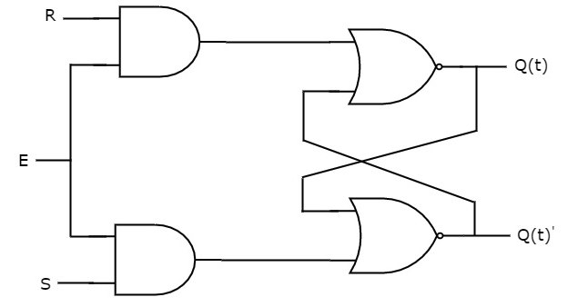
SR Latch
S | R | Q(t+1)
0 | 0 | Q(t)
0 | 1 | 0
1 | 0 | 1
1 | 1 | -
SR Latch also called a Set and Reset Latch
Functionally:
E: Used to enabled the circuit: i.e., trigger an update
R: Used to clear (reset) the memory unit
S: Used to set the memory unit
memory unit
Memory Cell Q(t)
Q(t)'
Q(t+1)
Q(t+1)
Must be complements
Q(t)
Q(t+1)'
A | B | NOR
0 | 0 | 1
0 | 1 | 0
1 | 0 | 0
1 | 1 | 0

Slide 5
SR Latch: Set at (1,0)
S | R | Q(t+1)
0 | 0 | Q(t)
0 | 1 | 0
1 | 0 | 1
1 | 1 | -
SR Latch also called a Set and Reset Latch
Functionally:
E: Used to enabled the circuit: i.e., trigger an update
R: Used to clear (reset) the memory unit
S: Used to set the memory unit
memory unit
1
1
Q(t) == ?
Q(t+1)
1
0000000000
10
Must be complements
1
00
1000000
A | B | NOR
0 | 0 | 1
0 | 1 | 0
1 | 0 | 0
1 | 1 | 0
1
1
Consider
with Q=0

Slide 6

D Latch: Data Latch
E | D | Q(t+1)
0 | 0 | Q(t)
0 | 1 | Q(t)
1 | 0 (reset) | 0
1 | 1 (set) | 1
Forces S & R to be complements
Functionally:
E: Used to trigger the memory unit, i.e., perform a write
D': Used to clear (reset) the memory unit
D: Used to set the memory unit
memory unit
1
1
1
1
Must be complements
0
A | B | NOR
0 | 0 | 1
0 | 1 | 0
1 | 0 | 0
1 | 1 | 0
0
0
D

Slide 7
Latches and Flip-Flops Logically the same!
Clk / E
Latches:
RS Latch
D Latch
JK Latch
T Latch
Flip-Flop:
RS Flip-Flop
D Flip-Flop
JK Flip-Flop
T Flip-Flop
D
Differences:
Latches | Flip-flops
Different underlying technology is used
Uses a enable signal | Uses a clock signal
Level triggered | Edge triggered
Consumes less power | Consumes more power
Faster | Slower
Used for transitioning (Consider a lock, e.g., at the Panama Canal.) | Used as storage

Slide 8
4-bit Register
D Flip-Flop
D₃
D₂
D₁
D₀
FF₃
FF₂
FF₁
FF₀
Clk
Q₃
Q₂
Q₁
Q₀

Slide 9
What do we have now?
Basic understanding of circuitry and its relationship to Boolean algebra.
Knowledge of "state" and how it is used to build registers and memory units
Recognize how we can build components to build a CPU
ALU, registers, decoders, multiplexers, etc., as well as main memory.
Almost ready for the abstract all this away in favor of an ISA Instruction Set Architecture
But first, let's put all the pieces together to create the MIPS microarchitecture!

Slide 10
MIPS: CPU Control
.text
int f( int a) {
int x;
int y;
int b;
x = a + 2; b = ( x > 0 )
if ( b )
x = x + b;
y = x * 3;
y = y << 2 ;
return y;
}
The CPU executes specific circuitry in stepwise fashion
Fetch, Decode, Execute, Mem Access, WriteBack
Unnamed Latches are used between each phase
PC: Program Counter
Holds the address of the NEXT instruction to be executed
The PC is increment by 1 instruction, i.e., 4 bytes, every cycle
Each instruction requires 4 bytes to encode
IR: Instruction Register
Stores the current instruction to be executed
Each instruction is decoded (electronically) to trigger operations in the circuitry
Three types of encodings: R, I, J
Operations involving the Registers and ALU
Operations involving Immediate values
Operations involving Jumps and Branches
pc

Slide 11
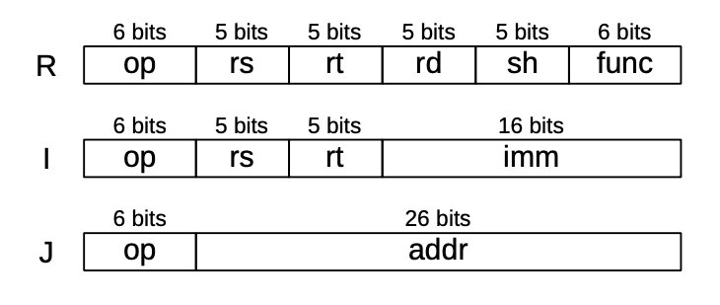
MIPS Instruction Set
Encoding: Instruction Register
Jump and Branch examples:
jal address ⇔ function call
jr rs ⇔ function return
beq rs, rt, imm ⇔ if (rs == rt ) goto imm
ALU examples:
add rd, rs, rt ⇔ rd = rs + rt → ADD $r0, $r2, $r3
ori rd, rs, imm ⇔ rd = rs | imm → ORI $r0, $r2, 5
Memory examples:
la rs, label ⇔ → $rs = &A
lb rt, imm(rs) ⇔ rt = SignExt( M₁ [rs + imm] ) → $rt = (char) A[0]
lwu rt, imm(rs) ⇔ rt = M₄ [rs + imm] → $rt = (unsigned word) ( A[16] )
sh rt, imm(rs) ⇔ M₂ [rs + imm] = rt → A[32] = (half) $rt

Slide 12
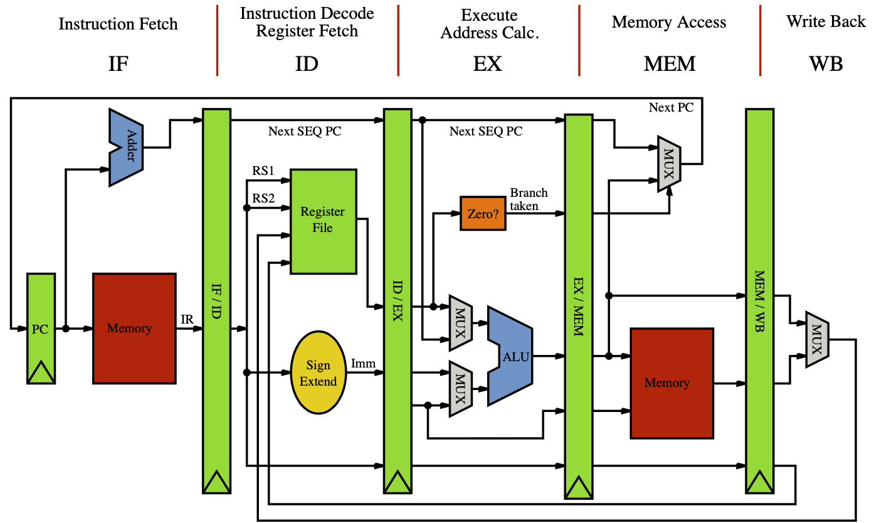
MIPS Pipeline Architecture
Fives Stages →
Major Sections:
PC update
ALU
Memory
PC update
next instruction
branch
(PC + 4) / ALU mux
ALU
imm / register mux
register / PC mux
Memory
Harvard Model
ALU / memory mux
label

Slide 13
label
IR

